Slide 1
Java 4 : Functional Programming
Notes:
Start recording

Slide 2
Agenda
Halfway there!
Chapter 2 Review
Chapter 3 Review
Final Project Check in
Chapter 4 – Functional Programming
Action Items for Next Class
Lab

Slide 3
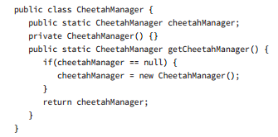
Chapter 2 Review
What changes need to be made to make the following singleton pattern correct?
Notes:
Question 9
A. None; the singleton pattern is properly implemented. B. Rename cheetahManager to instance. C. Rename getCheetahManager() to getInstance() . D. Change the access modifier of cheetahManager from public to private. E. Mark cheetahManager final. F. Add synchronized to getCheetahManager() .
D, F. A is incorrect, as there are definitely some problems with the singleton implementation. B and C are incorrect, as naming of the instance variable and access method are not required as part of the pattern. The public modifier on the cheetahManager instance means that any class can access or even replace the instance, which breaks the singleton pattern; hence D is required to fix the implementation. E is incorrect, as marking the instance final would prevent lazy instantiation and as the code would not compile. F is also required, since without this step two threads could create two distinct instances of the singleton at the same time, which would violate the singleton pattern.

Slide 4
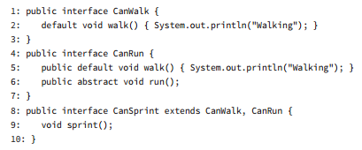
Chapter 2 Review
What is the result of the following code?
Notes:
Question 10
A. The code compiles without issue. B. The code will not compile because of line 5. C. The code will not compile because of line 6. D. The code will not compile because of line 8. E. The code will not compile because of line 9.
D. While Java supports multiple inheritance through interfaces, it does not support method overriding in interfaces, since it’s not clear which parent method should be used. In this example, CanWalk and CanRun both implement a default walk() method. The definition of CanSprint extends these two interfaces and therefore won’t compile as two default methods with the same signature from parent classes are detected, therefore the answer is D. None of the other lines of code cause problems, so the rest of the answers are not correct.

Slide 5
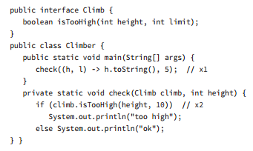
Chapter 2 Review
What is the result of the following code?
Notes:
Question 12
A. ok B. too high C. Compiler error on line x1. D. Compiler error on line x2. E. Compiler error on a different line. F. A runtime exception is thrown.
C. The functional interface takes two int parameters. The code on line x1 attempts to use them as if one is an Object, resulting in a compiler error making C the correct answer. It also tries to return String even though the data type for the functional interface method is boolean. It is tricky to use types in a lambda when they are implicitly specified. Remember to check the interface for the real type.

Slide 6
Chapter 2 Review
Which of the following statements about inheritance and object composition are correct?
A. Inheritance supports access to protected variables. B. Object composition tends to promote greater code reuse than inheritance. C. Inheritance relies on the has‐a principle. D. Object composition supports method overriding at runtime. E. Object composition requires a class variable to be declared public or accessible from a public method to be used by a class in a different package. F. Object composition is always preferred to inheritance.
Notes:
Question 18
A, B, E. A is correct, and it is one of the reasons to prefer class inheritance over object composition. B is also correct, since object composition tends to lead to classes that are easier to reference, as they don’t require knowledge of any parent classes. C is incorrect, as inheritance tends to use the is-a principle, whereas object composition relies on the has-a principle. D is incorrect, as this is a statement about inheritance, not object composition. E is correct, as object composition has no notion of inheritance and variables must be exposed publically if they are to be used by other classes in different packages. F is incorrect, as neither are always the right answer. There are situations where inheritance is more appropriate, and situations where object composition is more appropriate.

Slide 7
Chapter 2 Review
Which of the following are properties of classes that are properly encapsulated as a JavaBean?
A. All instance variables are marked final. B. boolean instance variables are accessed with is or get. C. All instance variables are marked private. D. They implement the JavaBean interface. E. Variables are created using lazy instantiation. F. The first letter of the any getter/setter, after the get, set, or is prefix, must be uppercase.
Notes:
Question 17
B, C, F. Options B, C, and F are each correct statements about JavaBean encapsulation. A is incorrect, as that is a property of the immutable object pattern, not encapsulation. D is incorrect, as there is no such JavaBean interface defined in the Java API. Finally, E is incorrect, as handling instantiation is not part of encapsulation.

Slide 8
Chapter 3 Lab Review
Create a Bank Helper class that sorts deposits of various objects into deposit boxes. Use Generics when creating your Sorting class, and account for paper currency, coin currency, and valuable objects. Run your Sorting class for all three types of objects and demonstrate that it works.
In-Class Example
Notes:
Banker Class containing Method DepositSorter
Interface Deposit
Deposit Enum
Classes Coin, Paper, ValuableItem
Comparison of Type

Slide 9
Chapter 3 Discussion Board
What's the point of using generic classes? What is the main benefit, and why would you want to implement them?
Your team is currently developing software that works with ingredients on an assembly line that is used to make several types of cheeses. What generic classes would you implement for this software?

Slide 10
Final Project Check In
Four weeks to go!
Requirements
Overall Design

Slide 11
Chapter 4 – Functional Programming
Using Variables in lambdas
In chapter 1, we learned that using the final modifier on a local variable meant it could no longer be updated
The same concept applies to lambda expressions. They can access these variables but not modify them

Slide 12
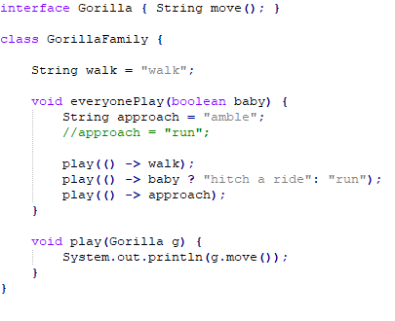
Chapter 4 – Functional Programming
Using Variables in lambdas
How many examples can you spot?
Notes:
Line 8 – Instance Variable
Line 9 – Method Parameter
Line 10 – final local variable
If we uncomment the line inside everyonePlay, there will be a reassignment and the variable will no longer be effectively final. This will cause a compile error

Slide 13
Chapter 4 – Functional Programming
Built-In Functional Interfaces
Functional Interface – Exactly one abstract method
Part of the java.util.function package

Slide 14
Chapter 4 – Functional Programming
Common Functional Interfaces
Interface | # Parameters | Return Type | Single Abstract Method
Supplier<T> | 0 | T | get
Consumer<T> | 1 (T) | void | accept
Predicate<T> | 1 (T) | boolean | test
Function<T, R> | 1 (T) | R | apply
UnaryOperator<T> | 1 (T) | T | apply
Notes:
Won’t need to memorize each table, as we’ll be going through them together.
We typiucally don’t actually assign the implementation of the interface to a variable. The interface name is implied and it gets passed directly to the method that needs it. The names are used to better understand and remember what is going on.
You can name the functional interface whatever you want.
Only requirements is that it must be a valid interface name and contain a single abstract method.

Slide 15
Chapter 4 – Functional Programming
Common Functional Interfaces
Interface | # Parameters | Return Type | Single Abstract Method
BiConsumer<T, U> | 2 (T, U) | void | accept
BiPredicate<T, U> | 2 (T, U) | boolean | test
BiFunction<T, U, R> | 2 (T, U) | R | apply
BinaryOperator<T> | 2 (T, T) | T | apply

Slide 16

Chapter 4 – Functional Programming
Implementing Supplier
Supplier is used when you want to generate or supply values without taking input

Slide 17
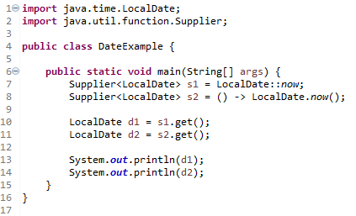
Chapter 4 – Functional Programming
Implementing Supplier
Notes:
2020-09-06
2020-09-06

Slide 18
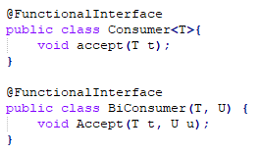
Chapter 4 – Functional Programming
Implementing Consumer and BiConsumer
Consumer – Want to perform an operation with a parameter but not return anything
BiConsumer – Want to perform an operation with two parameters but not return anything

Slide 19
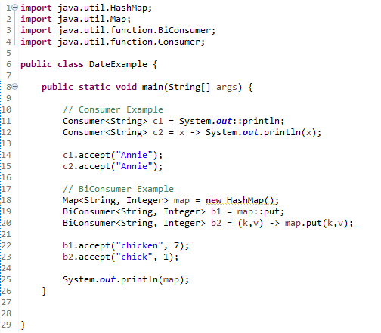
Chapter 4 – Functional Programming
Implementing Consumer and BiConsumer
Notes:
Annie
Annie
{chicken=7, chick=1}
Note, BiConsumer doesn’t necessarily need to be of the same type
Note: :: is the method reference operator from last class

Slide 20
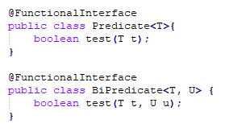
Chapter 4 – Functional Programming
Implementing Predicate and BiPredicate
Predicate is used when filtering or matching

Slide 21
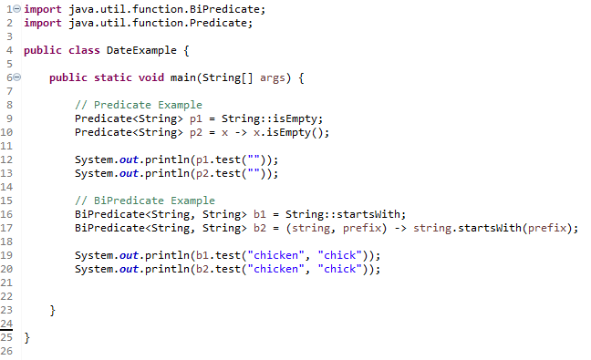
Chapter 4 – Functional Programming
Implementing Predicate and BiPredicate
Notes:
true
true
true
true

Slide 22
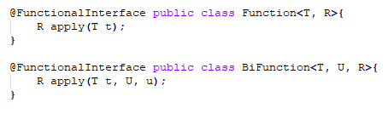
Chapter 4 – Functional Programming
Implementing Function and BiFunction
A function is responsible for turning one parameter into a value of a potentially different type and returning it
A BiFunction is responsible for turning two parameters into a value and returning it.

Slide 23
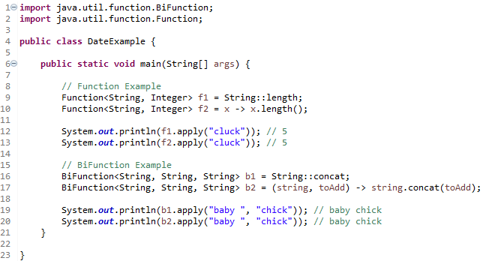
Chapter 4 – Functional Programming
Implementing Function and BiFunction
Notes:
You’re welcome to implement your own custom interfaces for TriFunction or QuadFunction
5
5
Baby chick
Baby chick

Slide 24

Chapter 4 – Functional Programming
Implementing UnaryOperator and BinaryOperator
UnaryOperator and BinaryOperator are special case functions
Both require all type parameters to be the same type
UnaryOperator transforms its value into one of the same type
BinaryOperator merges two values ito one of the same type
Notes:
Incrementing by one is a unary option
UnaryOperator extends Function
BinaryOperator extends BiFunction

Slide 25
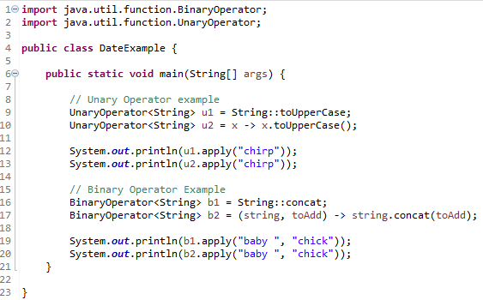
Chapter 4 – Functional Programming
Implementing UnaryOperator and BinaryOperator
Notes:
CHIRP
CHIRP
baby chick
baby chick

Slide 26
Chapter 4 – Functional Programming
Checking Functional Interfaces
What functional Interface would you use in these three situations?
Returns a String without taking any parameters
Returns a Boolean and takes a String
Returns an Integer and takes two Integers
Notes:
These are incredibly important to know for the OCA exam and MidTerm
Supplier – Generates an object and takes zero parameters
Function – Accepts a parameter and returns another type – this is not a predicate because a predicate returns a Boolean primitive and not a Boolean object
BinaryOperator or Bi Function. Binary Operator is a special case of BiFunction either is correct. BinaryOperator is the better answer because it’s more specific.

Slide 27
Chapter 4 – Functional Programming
Checking Functional Interfaces
What functional interface would you use to fill in the blanks?
__ <List> ex1 = x -> “”.equals(x.get(0));
__ <Long> ex2 = (Long l) -> System.out.println(l);
__ <String, String> ex3 = (s1, s2) -> false;
Notes:
Ex1 passes one String parameter to the lambda and returns a Boolean – This tells us that this is a predicate or function. Since the generic declaration has only one parameter, it is a predicate.
Ex2 passes one Long parameter to the lambda and doesn’t return anything, this tells us that it’s a Consumer.
Ex3 takes two parameters and returns a Boolean. When you see a Boolean returned, think Predicate unless the generics specify a Boolean return type. In this case, there are two parameters so it is a BiPredicate
The OCA exam makes these really tricky.

Slide 28
Chapter 4 – Functional Programming
Returning an Optional
Optional Type - Java equivalent of “we don’t know” or “not applicable”
Optional is created using a factory
You can either request an empty optional or pass a value for the Optional to wrap

Slide 29
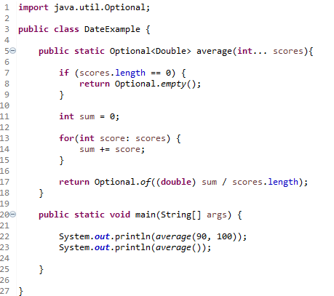
Chapter 4 – Functional Programming
Returning an Optional
Notes:
… is a vararg. They let you pass any number of objects of a specific type
Optional[95.0]
Optional.empty

Slide 30
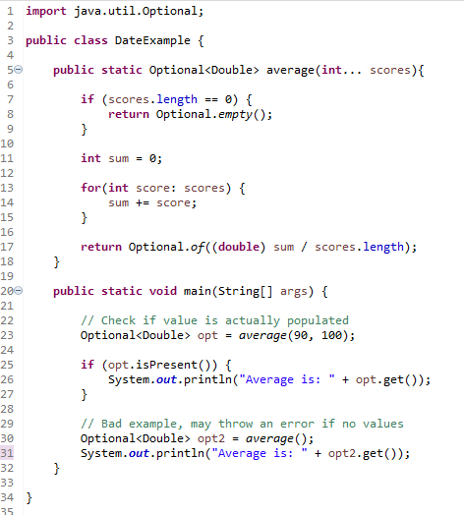
Chapter 4 – Functional Programming
Returning an Optional
Notes:
… is a vararg. They let you pass any number of objects of a specific type
Optional[95.0]
Optional.empty

Slide 31
Chapter 4 – Functional Programming
Optional Instance Methods
Method | When Option is empty | When Optional has value
get() | Throws an Exception | Returns a value
ifPresent(Consumer c) | Does nothing | Calls Consumer with value
isPresent() | Returns false | Returns true
orElse(T other) | Returns other parameter | Returns value
orElseGet(Supplier s) | Returns result of calling Supplier | Returns value
orElseThrow(Supplier s) | Throws exception created by Supplier | Returns value

Slide 32
Chapter 4 – Functional Programming
Using Streams
In Java, a stream is a sequence of data
A Stream pipeline is the operations that run on a stream to produce a result
Think of as an Assembly Line in a factory
Stream Operation is an event that occurs somewhere in the stream pipeline

Slide 33
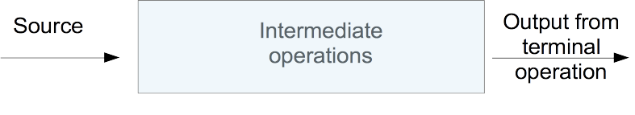
Chapter 4 – Functional Programming
Using Streams
Source – Where the stream comes from
Intermediate Operations – Transforms the stream into another one.
Terminal Operation – Actually produces a result.
Notes:
The blue box is the implementation detail, the outside only cares about the Source and Output, this is abstracted.

Slide 34
Chapter 4 – Functional Programming
Using Streams
Scenario | For intermediate operations? | For terminal operations?
Required part of stream pipeline? | No | Yes
Can exist multiple times in pipeline? | Yes | No
Return type is a stream type? | Yes | No
Executed on method call? | No | Yes
Stream valid after call? | Yes | No
Notes:
The blue box is the implementation detail, the outside only cares about the Source and Output, this is abstracted.

Slide 35
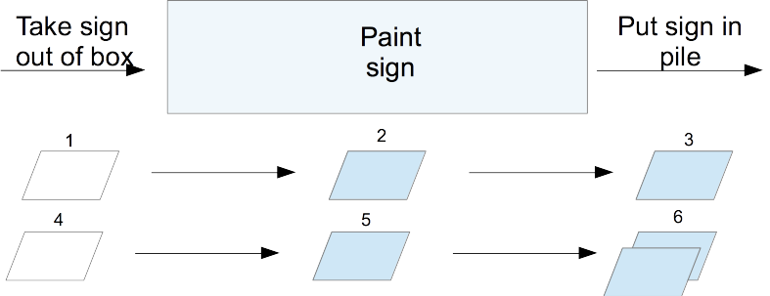
Chapter 4 – Functional Programming
Following the Flow
Consider that we need to paint signs using Functional Programming
Notes:
In a factory, the foreman typically oversees the work. Java serves as the foreman when working with stream pipelines.
Let’s take a look at what happens from the point of the view of the foreman. First, he sees that the source is taking signs out of the box. The foreman sets up a worker at the table to unpack the box and says to await a signal to start. Then the foreman sees the intermediate operation to paint the sign. He sets up a worker with paint and says to await a signal to start. Finally, the foreman sees the terminal operation to put the signs into a pile. He sets up a worker to do this and yells out that all three workers should start.

Slide 36
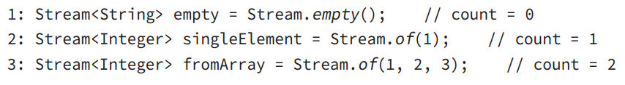
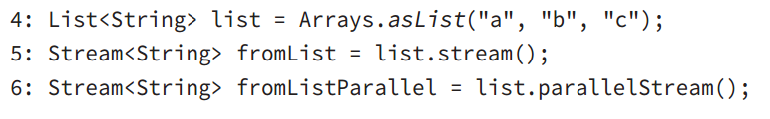
Chapter 4 – Functional Programming
Creating Stream Sources
Notes:
Line 1 shows how to create an empty stream. Line 2 shows how to create a stream with a single element. Line 3 shows how to create a stream from an array. You’ve undoubtedly noticed that there isn’t an array on line 3. The method signature uses varargs, which let you specify an array or individual elements. Since streams are new in Java 8, most code that’s already written uses lists.
Java provides a convenient way to convert from a list to a stream:
Line 5 shows that it is a simple method call to create a stream from a list. Line 6 does the same, except that it creates a stream that is allowed to process elements in parallel. This is a great feature because you can write code that uses parallelism before even learning what a thread is. Using parallel streams is like setting up multiple tables of workers who are able to do the same task. Painting would be a lot faster if we could have f ve painters painting different signs at once. Just keep in mind that it isn’t worth working in parallel for small streams. There is an overhead cost in coordinating the work among all of the workers operating in parallel. For small amounts of work, it is faster just to do it sequentially. You’ll learn much more about running in parallel in Chapter 7 , “Concurrency.”

Slide 37
Chapter 4 – Functional Programming
Creating Stream Sources
Notes:
Line 7 generates a stream of random numbers. How many random numbers? However many you need. If you callrandoms.forEach(System.out::println) , the program will print random numbers until you kill it. Later in the chapter, you’ll learn about operations like limit() to turn the infnite stream into a finite stream.
Line 8 gives you more control.iterate() takes a seed or starting value as the first parameter. This is the first element that will be part of the stream. The other parameter is a lambda expression that gets passed the previous value and generates the next value. As with the random numbers example, it will keep on producing odd numbers as long as you need them.

Slide 38
Chapter 4 – Functional Programming
Common Terminal Operations
You can perform a terminal operation without any intermediate operations, but not the other way around
Reductions – all contents of the stream are combined into a single primitive or object

Slide 39
Chapter 4 – Functional Programming
Method | Terminates for infinite streams? | Return value | Reduction?
allMatch() anyMatch() noneMatch() | Sometimes | boolean | No
collect() | No | Varies | Yes
count() | No | long | Yes
findAny() findFirst() | Yes | Optional<T> | No
forEach() | No | void | No
max() min() | No | Optional<T> | Yes
reduce() | No | Varies | Yes
Common Terminal Operations

Slide 40

Chapter 4 – Functional Programming
Common Terminal Operations
Count() – determines the number of elements in a finite stream
Hangs during an infinite stream
Notes:
The count() method determines the number of elements in a fiite stream. For an infiite stream, it hangs. Why? Count from 1 to infiity and let us know when you are fiished. Or rather don’t do that because we’d rather you study for the exam than spend the rest of your life counting. count() is a reduction because it looks at each element in the stream and returns a single value.

Slide 41

Chapter 4 – Functional Programming
Common Terminal Operations
Min() and Max() – allows you to pass a custom comparator and find the smallest or largest value in a finite stream
Hangs on an infinite stream
Notes:
Both methods are reductions because they return a single value after looking at the entire stream.
Monkey

Slide 42

Chapter 4 – Functional Programming
Common Terminal Operations
findAny() and findFirst() – Returns an element of the stream unless the stream is empty.
If the stream is empty, they return an empty optional
Notes:
Since Java generates only the amount of stream you need, the infiite stream needs to generate only one element. findAny() is useful when you are working with a parallel stream. It gives Java the flxibility to return to you the fist element it comes by rather than the one that needs to be fist in the stream based on the intermediate operations. These methods are terminal operations but not reductions. The reason is that they sometimes return without processing all of the elements. This means that they return a value based on the stream but do not reduce the entire stream into one value.
Monkey
Chimp
Finding any one match is more useful than it sounds. Sometimes we just want to sample the results and get a representative element, but we don’t need to waste the processing generating them all. After all, if we plan to work with only one element, why bother looking at more?

Slide 43
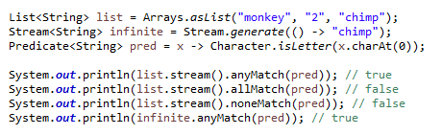
Chapter 4 – Functional Programming
Common Terminal Operations
allMatch(), anyMatch(), and noneMatch()
Search a stream and return information about how the stream pertains to the predicate
Notes:
These may or may not terminate for infinite streams. It depends on the data. Like the find methods, they are not reductions because they do not necessarily look at all of the elements.
true
false
false
true
This shows that we can reuse the same predicate, but we need a different stream each time. anyMatch() returnstrue because two of the three elements match.allMatch() returnsfalse because one doesn’t match.noneMatch() also returnsfalse because one matches. On the inf nite list, one match is found, so the call terminates. If we callednoneMatch() orallMatch() , they would run until we killed the program.

Slide 44

Chapter 4 – Functional Programming
Common Terminal Operations
forEach()
Looping Construct
Notes:
Before you use it, consider if another approach would be better. Developers who learned to write loops f rst tend to use them for everything. For example, a loop with anif statement should be a f lter instead.

Slide 45
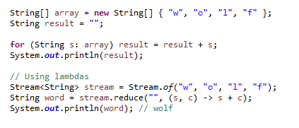
Chapter 4 – Functional Programming
Common Terminal Operations
reduce()
Combines a stream into a single object
Notes:
Let’s take them one at a time. The most common way of doing a reduction is to start with an initial value and keep merging it with the next value. Think about how you would concatenate an array ofString s into a singleString without functional programming. It might look something like this:
The initial value of an emptyString is the identity. The accumulator combines the current result with the currentString . With lambdas, we can do the same thing with a stream and reduction:

Slide 46

Chapter 4 – Functional Programming
Common Terminal Operations
collect() – retrieves data from the stream and collects it into other forms
A mutable reduction
Notes:
Typo on page 195
The fist parameter is a Supplier that creates the object that will store the results as we collect data. Remember that a Supplier doesn’t take any parameters and returns a value. In this case, it constructs a new StringBuilder. The second parameter is a BiConsumer, which takes two parameters and doesn’t return anything. It is responsible for adding one more element to the data collection. In this example, it appends the next String to the StringBuilder. The fial parameter is another BiConsumer. It is responsible for taking two data collections and merging them. This is useful when we are processing in parallel. Two smaller collections are formed and then merged into one. This would work with StringBuilder only if we didn’t care about the order of the letters. In this case, the accumulator and combiner have similar logic.
The collector has three parts as before. The supplier creates an empty TreeSet. The accumulator adds a single String from the Stream to the TreeSet. The combiner adds all of the elements of one TreeSet to another in case the operations were done in parallel and need to be merged.

Slide 47
Chapter 4 – Functional Programming
Common Intermediate Operations
filter() – returns a stream with elements that match a given expression

Slide 48
Chapter 4 – Functional Programming
Common Intermediate Operations
distinct() – returns a stream with duplicate values removed

Slide 49

Chapter 4 – Functional Programming
Common Intermediate Operations
limit() and skip() – make a stream smaller or make a finite stream out of an infinite stream

Slide 50
Chapter 4 – Functional Programming
Common Intermediate Operations
map() – creates a one-to-one mapping from the elements in the stream to the elements of the next step in the stream

Slide 51
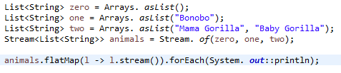
Chapter 4 – Functional Programming
Common Intermediate Operations
flatMap() – takes each element in the stream and makes any elements it contains top-level elements in a single stream
Helpful when you want to remove empty elements or combine lists

Slide 52

Chapter 4 – Functional Programming
Common Intermediate Operations
sorted() – returns a stream with the elements sorted
Natural ordering used unless using a comparator
Notes:
bear-brown-

Slide 53
Chapter 4 – Functional Programming
Common Intermediate Operations
peek() – allows us to perform a stream operation without actually changing the stream
Notes:
The most common use forpeek() is to output the contents of the stream as it goes by. Suppose that we made a typo and counted bears beginning with the letterg instead ofb . We are puzzled why the count is 1 instead of 2. We can add apeek() to f nd out why:

Slide 54
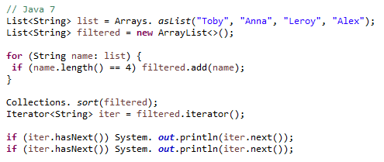
Chapter 4 – Functional Programming
Putting together the pipeline
Notes:
Let’s say that we wanted to get the fist two names alphabetically that are four characters long. This works. It takes some reading and thinking to fiure out what is going on. The problem we are trying to solve gets lost in the implementation. It is also very focused on the how rather than on the what. Alex
Anna

Slide 55
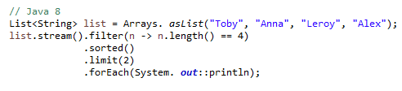
Chapter 4 – Functional Programming
Putting together the pipeline
Notes:
The difference is that we express what is going on. We care about String objects of length 4. Then we then want them sorted. Then we want to fist two. Then we want to print them out. It maps better to the problem that we are trying to solve, and it is simpler because we don’t have to deal with counters and such. Once you start using streams in your code, you may fid yourself using them in many places. Having shorter, briefer, and clearer code is defiitely a good thing!

Slide 56
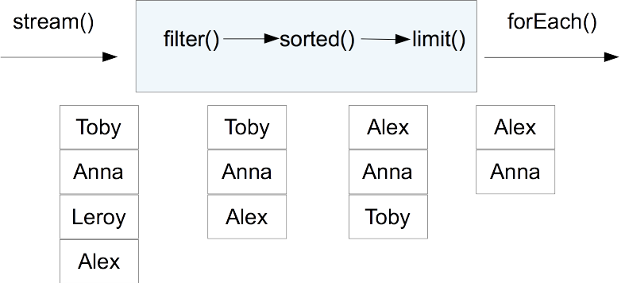
Chapter 4 – Functional Programming
Putting together the pipeline
Notes:
The difference is that we express what is going on. We care about String objects of length 4. Then we then want them sorted. Then we want to fist two. Then we want to print them out. It maps better to the problem that we are trying to solve, and it is simpler because we don’t have to deal with counters and such. Once you start using streams in your code, you may fid yourself using them in many places. Having shorter, briefer, and clearer code is defiitely a good thing!

Slide 57
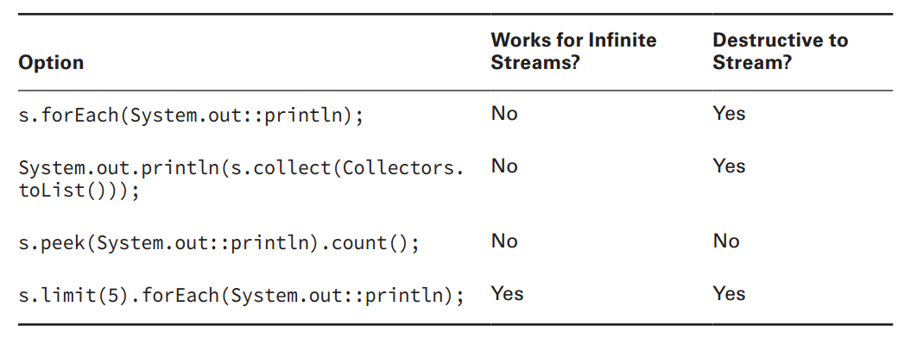
Chapter 4 – Functional Programming
Troubleshooting
Notes:
Notice that most of the approaches are destructive. This means that you cannot use the stream anymore after printing. This is fie when you are getting started and just want to see what the code does. It’s a problem if you are trying to fid out what a stream looks like as it passes through a certain part of the pipeline. Also, notice that only one of the approaches works for an infiite stream. It limits the number of elements in the stream before printing. If you try the others with an infiite stream, they will run until you kill the program.

Slide 58
Chapter 4 – Functional Programming
Working with primitives
IntStream – Used for the primitive types int, short, byte, and char
LongStream – Used for the primitive type long
DoubleStream – Used for the primitive types double and float

Slide 59
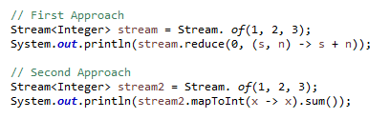
Chapter 4 – Functional Programming
Working with primitives
Notes:
Let’s take a look at why this is needed. Suppose that we want to calculate the sum of numbers in a fiite stream: Not bad. It wasn’t hard to write a reduction. We started the accumulator with zero. We then added each number to that running total as it came up in the stream. There is another way of doing that: This time, we converted our Stream<Integer> to an IntStream and asked the IntStream to calculate the sum for us. The primitive streams know how to perform certain common operations automatically.

Slide 60
Chapter 4 – Functional Programming
Working with primitives
Source | To Stream | To DoubleStream | To IntStream | To LongStream
Stream | map | mapToDouble | mapToInt | mapToLong
Double Stream | mapToObj | map | mapToInt | mapToLong
IntStream | mapToObj | mapToDouble | map | mapToLong
LongStream | mapToObj | mapToDouble | mapToInt | map

Slide 61
Chapter 4 – Functional Programming
Working with primitives
Source | To Stream | To DoubleStream | To IntStream | To LongStream
Stream | map | mapToDouble | mapToInt | mapToLong
Double Stream | mapToObj | map | mapToInt | mapToLong
IntStream | mapToObj | mapToDouble | map | mapToLong
LongStream | mapToObj | mapToDouble | mapToInt | map

Slide 62
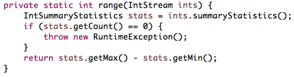
Chapter 4 – Functional Programming
Retrieving Statistics
Notes:
Here we asked Java to perform many calculations about the stream. This includes the minimum, maximum, average, size, and the number of values in the stream. If the stream were empty, we’d have a count of zero. Otherwise, we can get the minimum and maximum out of the summary.

Slide 63
Key Takeaways
What you need to know
Identify the correct functional interface given the number of parameters, return type, and method name – and vice versa
Write code that uses optional
Recognize which operations cause a stream pipeline to execute
Determine which terminal operations are reductions

Slide 64
Key Takeaways
What you need to know
Write code for the common intermediate operations
Compare primitive streams to stream
Convert primitive stream types to other primitive stream types
Translate coding using method references into lambdas and vice versa
Use peek() to inspect the stream
Search a stream
Sort a Stream

Slide 65
Action Items for next class
Complete and submit Lab 4 – Functional Programming
Check Blackboard grades and make sure they’re accurate

Slide 66
Upcoming Points Breakdown
Assignment | Points | Due Date
Programming Assignment | 25 | Start of Next Class
Concurrency Assignment | 25 | Final day of class
Participation | 25 | During Class
Discussion Board | 25 | Start of Next Class
 | Total: 100

